Slide 1
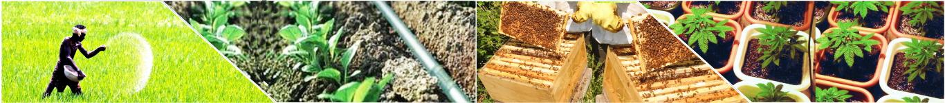

Gov-TechThon 2020 An IEEE Virtual Hackathon Supported by Oracle India
Team Name : KISAN SHAKTI
Team Leader : Shreyansh Sancheti
Team members:
Akash Fuse
Gurunatharudh Bhandarkavthe
Onkar Hanchate
Shubham Shinge

Slide 2
IDEA/APPROACH DETAILS
Problem statement : Seed supply chain is a complex ecosystem involving various stakeholders. Seed quality issues have demanded a need for effective traceability solution. Several important criteria such as origin of the seed, stages in production, conformance to quality standards such as genetic purity, germination rate etc. are to be validated
Solution :
A Decentralized Web Application which is used for transaction of seed and maintaining the quality of seed between Manufacturers,different distributors and farmers.
The Transactions in App are executed using BlockChain concept.
Authorities can use this system as supplementary to enforce regulation and the data collected can be used to predict demand and supply more precisely.

Slide 3
The consumers could get good quality seeds at cheaper rates right from the manufacturer.
An efficient supply chain can be ensured with point to point update over the immutable chains. Customers could choose specific farmers for specific seeds.
The farmers can build consumer loyalty based on the quality of seed and type of farming, which could eventually yield him better profits.

Slide 4
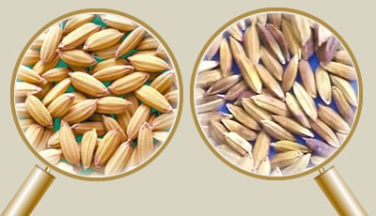
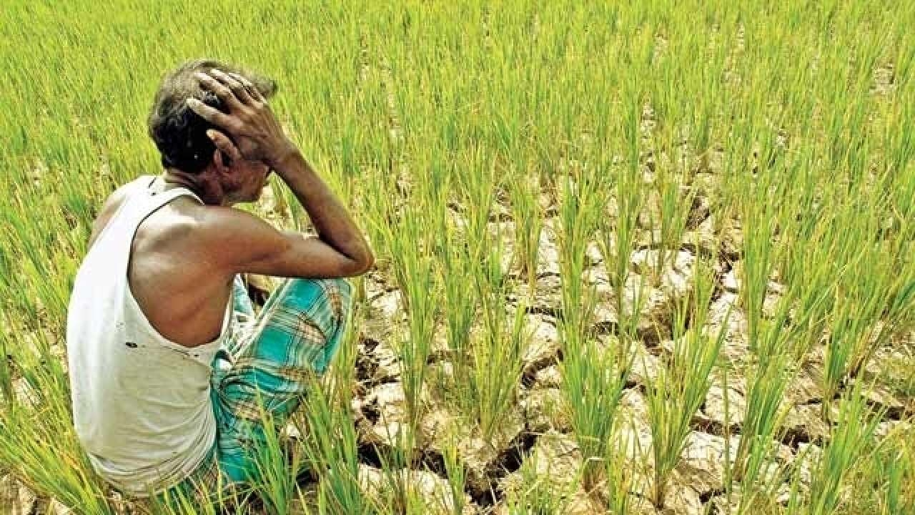
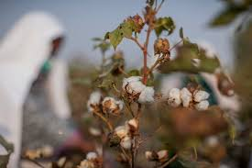
low germination, mixed varieties, low plant vigor, diseased plants, or the introduction of weeds seed source may be discolored seeds may be of different sizes and varieties seed source may contain inert, weeds or other matter | There are 7 suicides every day in Maharashtra. TOI | Reasons : Failure of crops : 16.84% Other reasons : 15.04% Family problems :13.27% Debt burden : 2.65% Losses in non-farm : 1.77% Failure of bore well : 0.88% Political affiliation : 4.42%

Slide 5
System Prototype:
All the distributors, retailers, manufacturers will have an account in our DApp.
Every transaction done between every distributor is been accounted using the Decentralized web app by distributor.
When any of the transaction takes place the validation of the transaction is done by all the distributors account in App. This is done using blockchain concept.
So whenever any fraud transaction of seed is attempted a alert to ministry office get’s raised.
As blockchain is used the record is maintained with everyone so no one can alter records keeping it hack free.
Our product support Multi-Language.
Our product will also support rating and feedbacks for distributors and seed quality

Slide 6
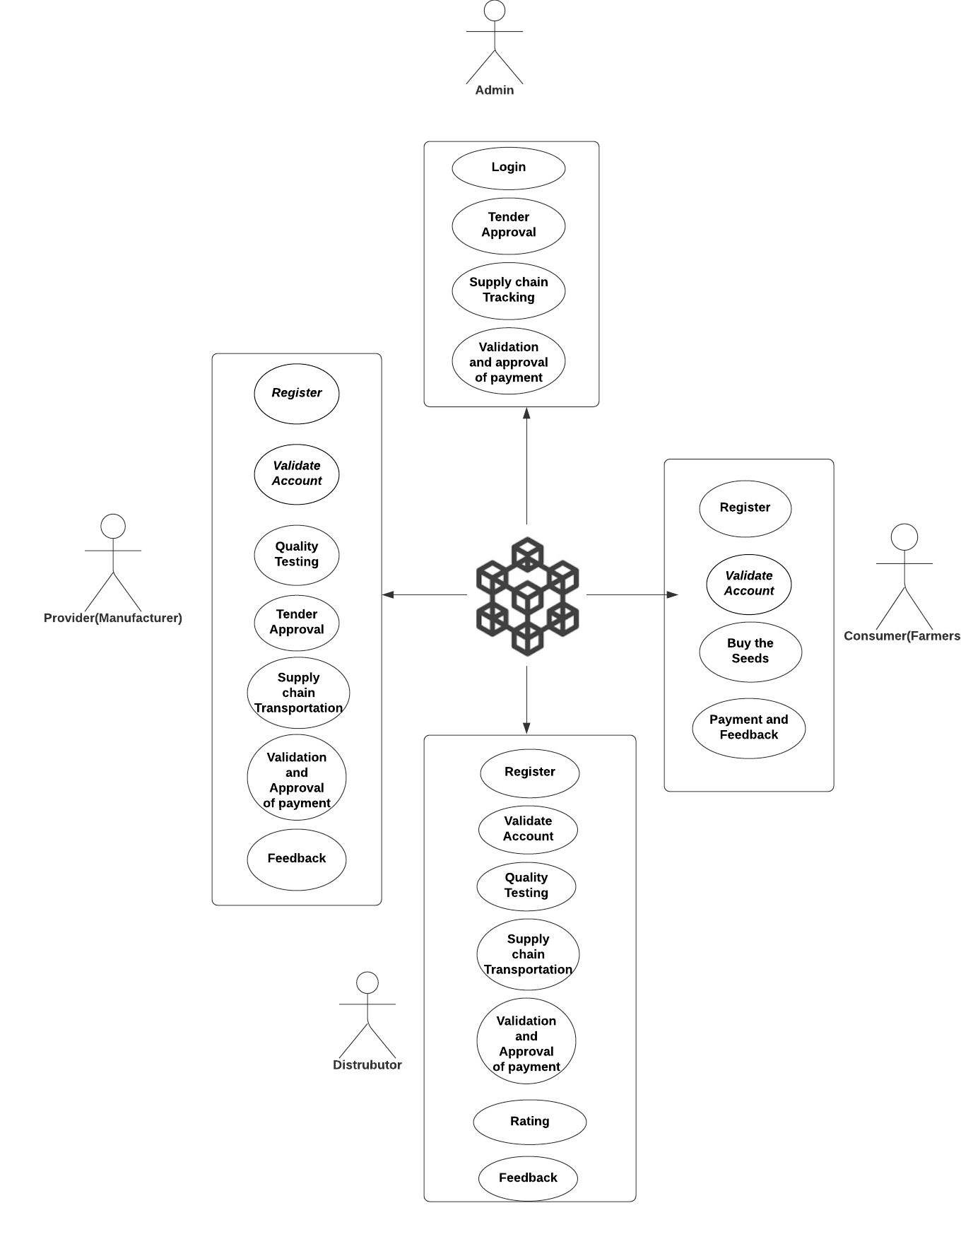
Use Case :

Slide 7

Technology Stack:
Front End : HTML5 , CSS , ReactJS
Backend : Nodejs
Platform : Web
Technology :Etherium Virtual Machine(EVM), Truffle IDE and smart contracts, Oracle Cloud Blockchain.
Dependencies :
Admin
Provider
Distributor of seeds
Consumers(Farmers) Admin
References :
https://seednet.gov.in/GraphReport/SeedGraph.aspx
https://www.tandfonline.com/doi/abs/10.1080/02571862.2011.10640009

Slide 8
Thank You !

